Slide 1

AI Driven Analysis of Trade Tariff Impacts on Consumer Prices in the U.S.
Munkhbayasgalan Ganaa
MS. Data Science, Regis University

Slide 2
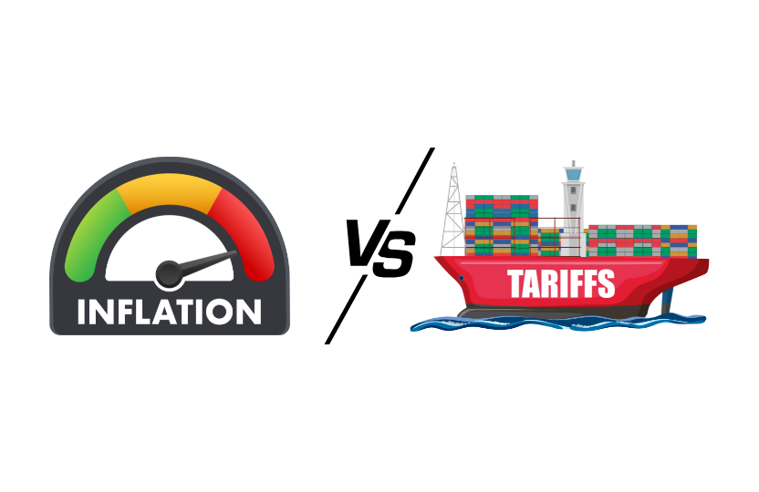
Do Tariff really drive Inflation?

Slide 3
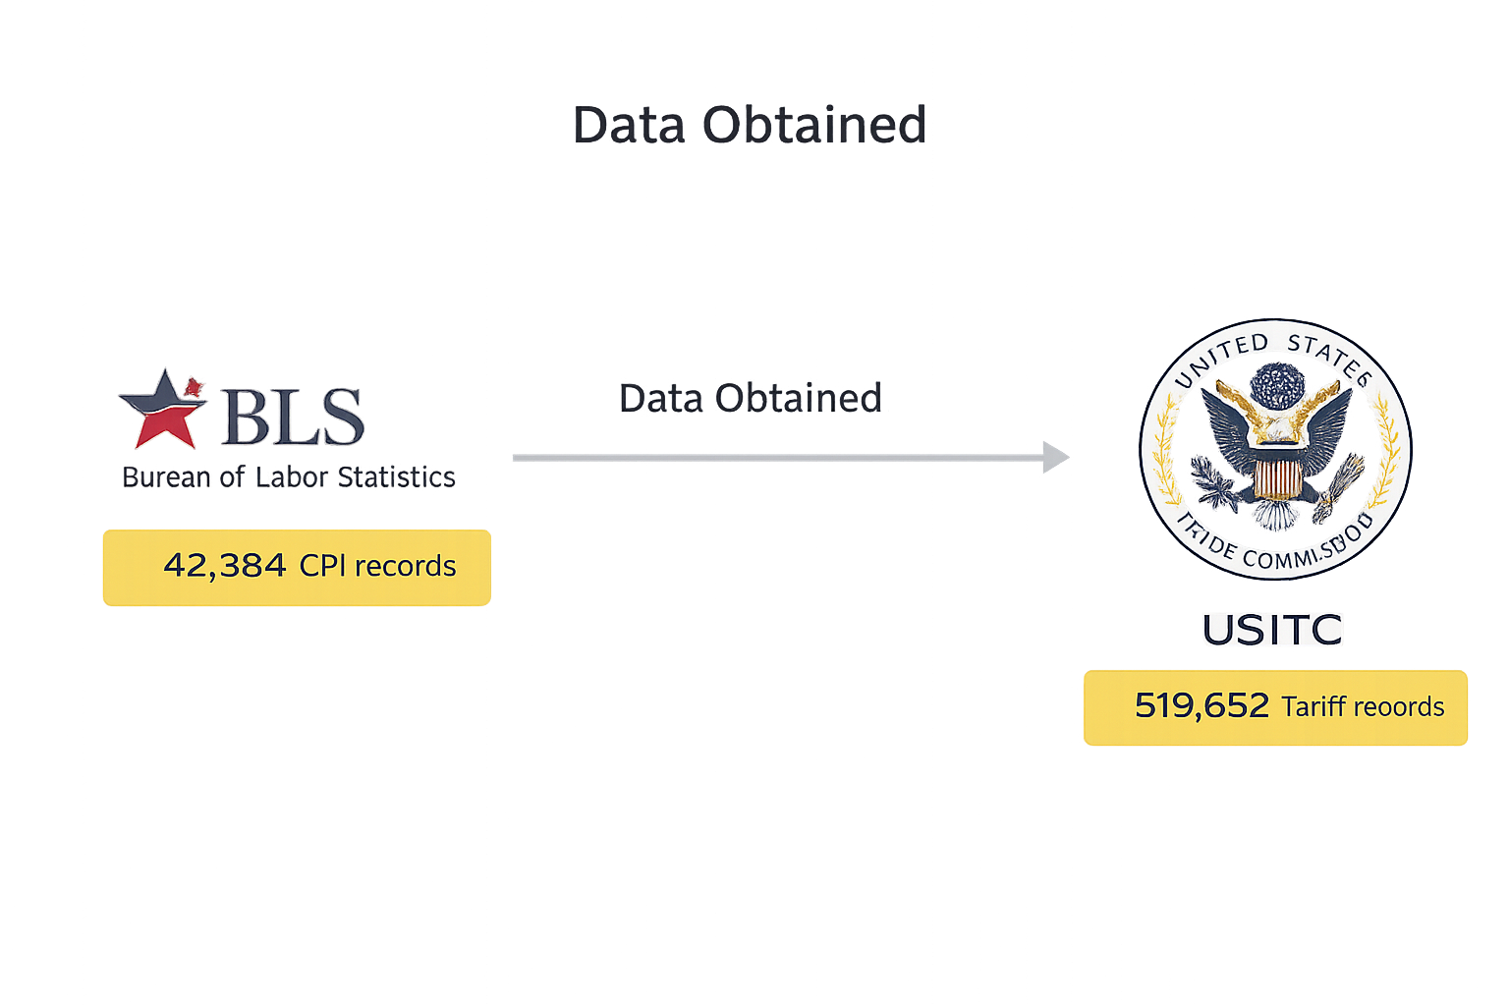

Slide 4
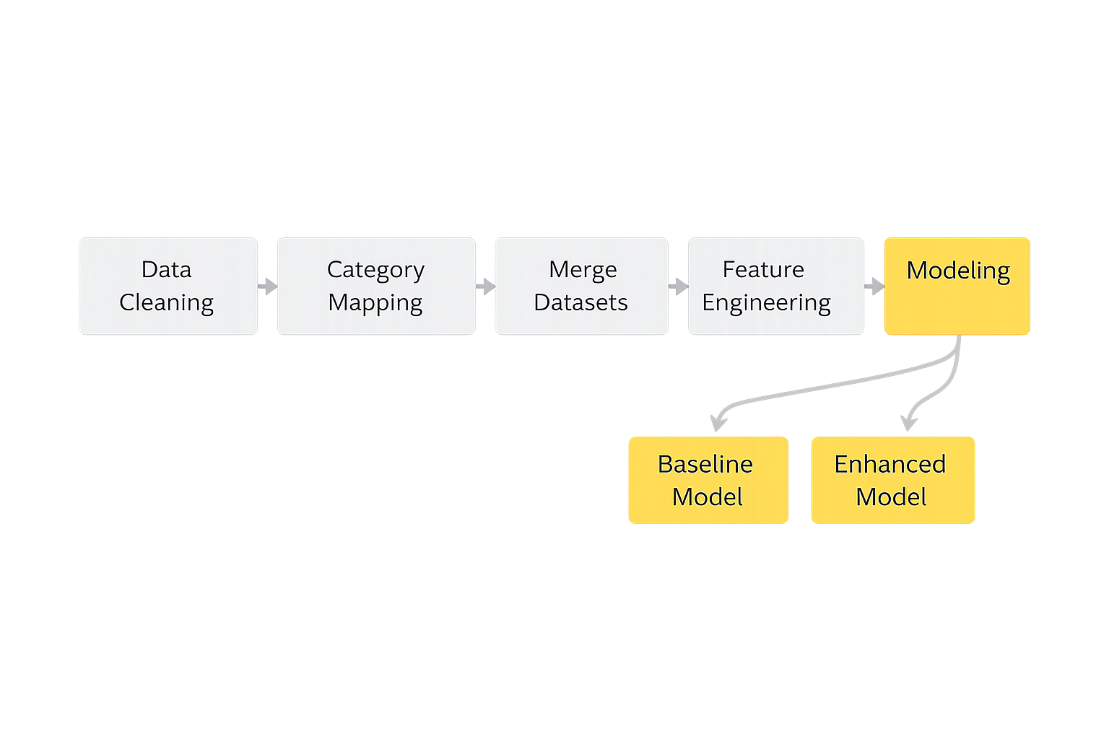
Method Pipeline

Slide 5
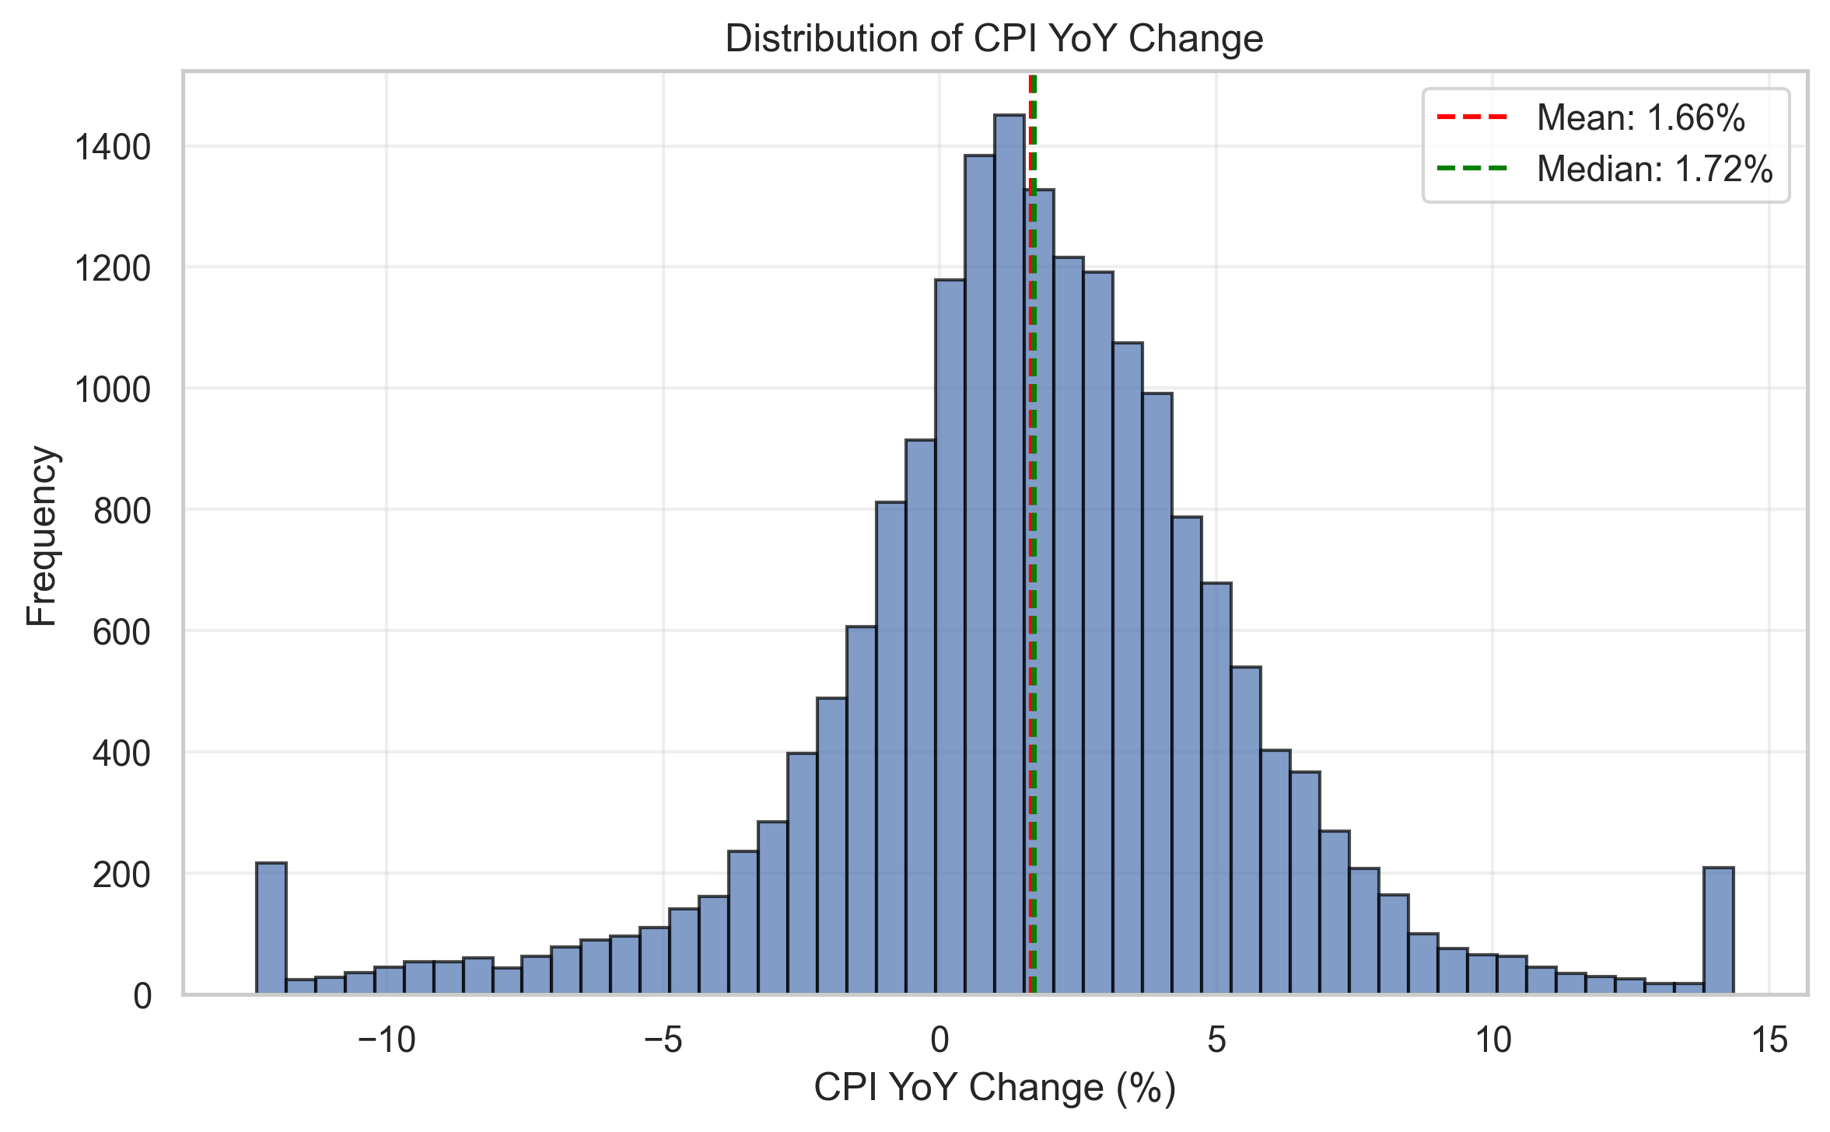
What the data looks like

Slide 6
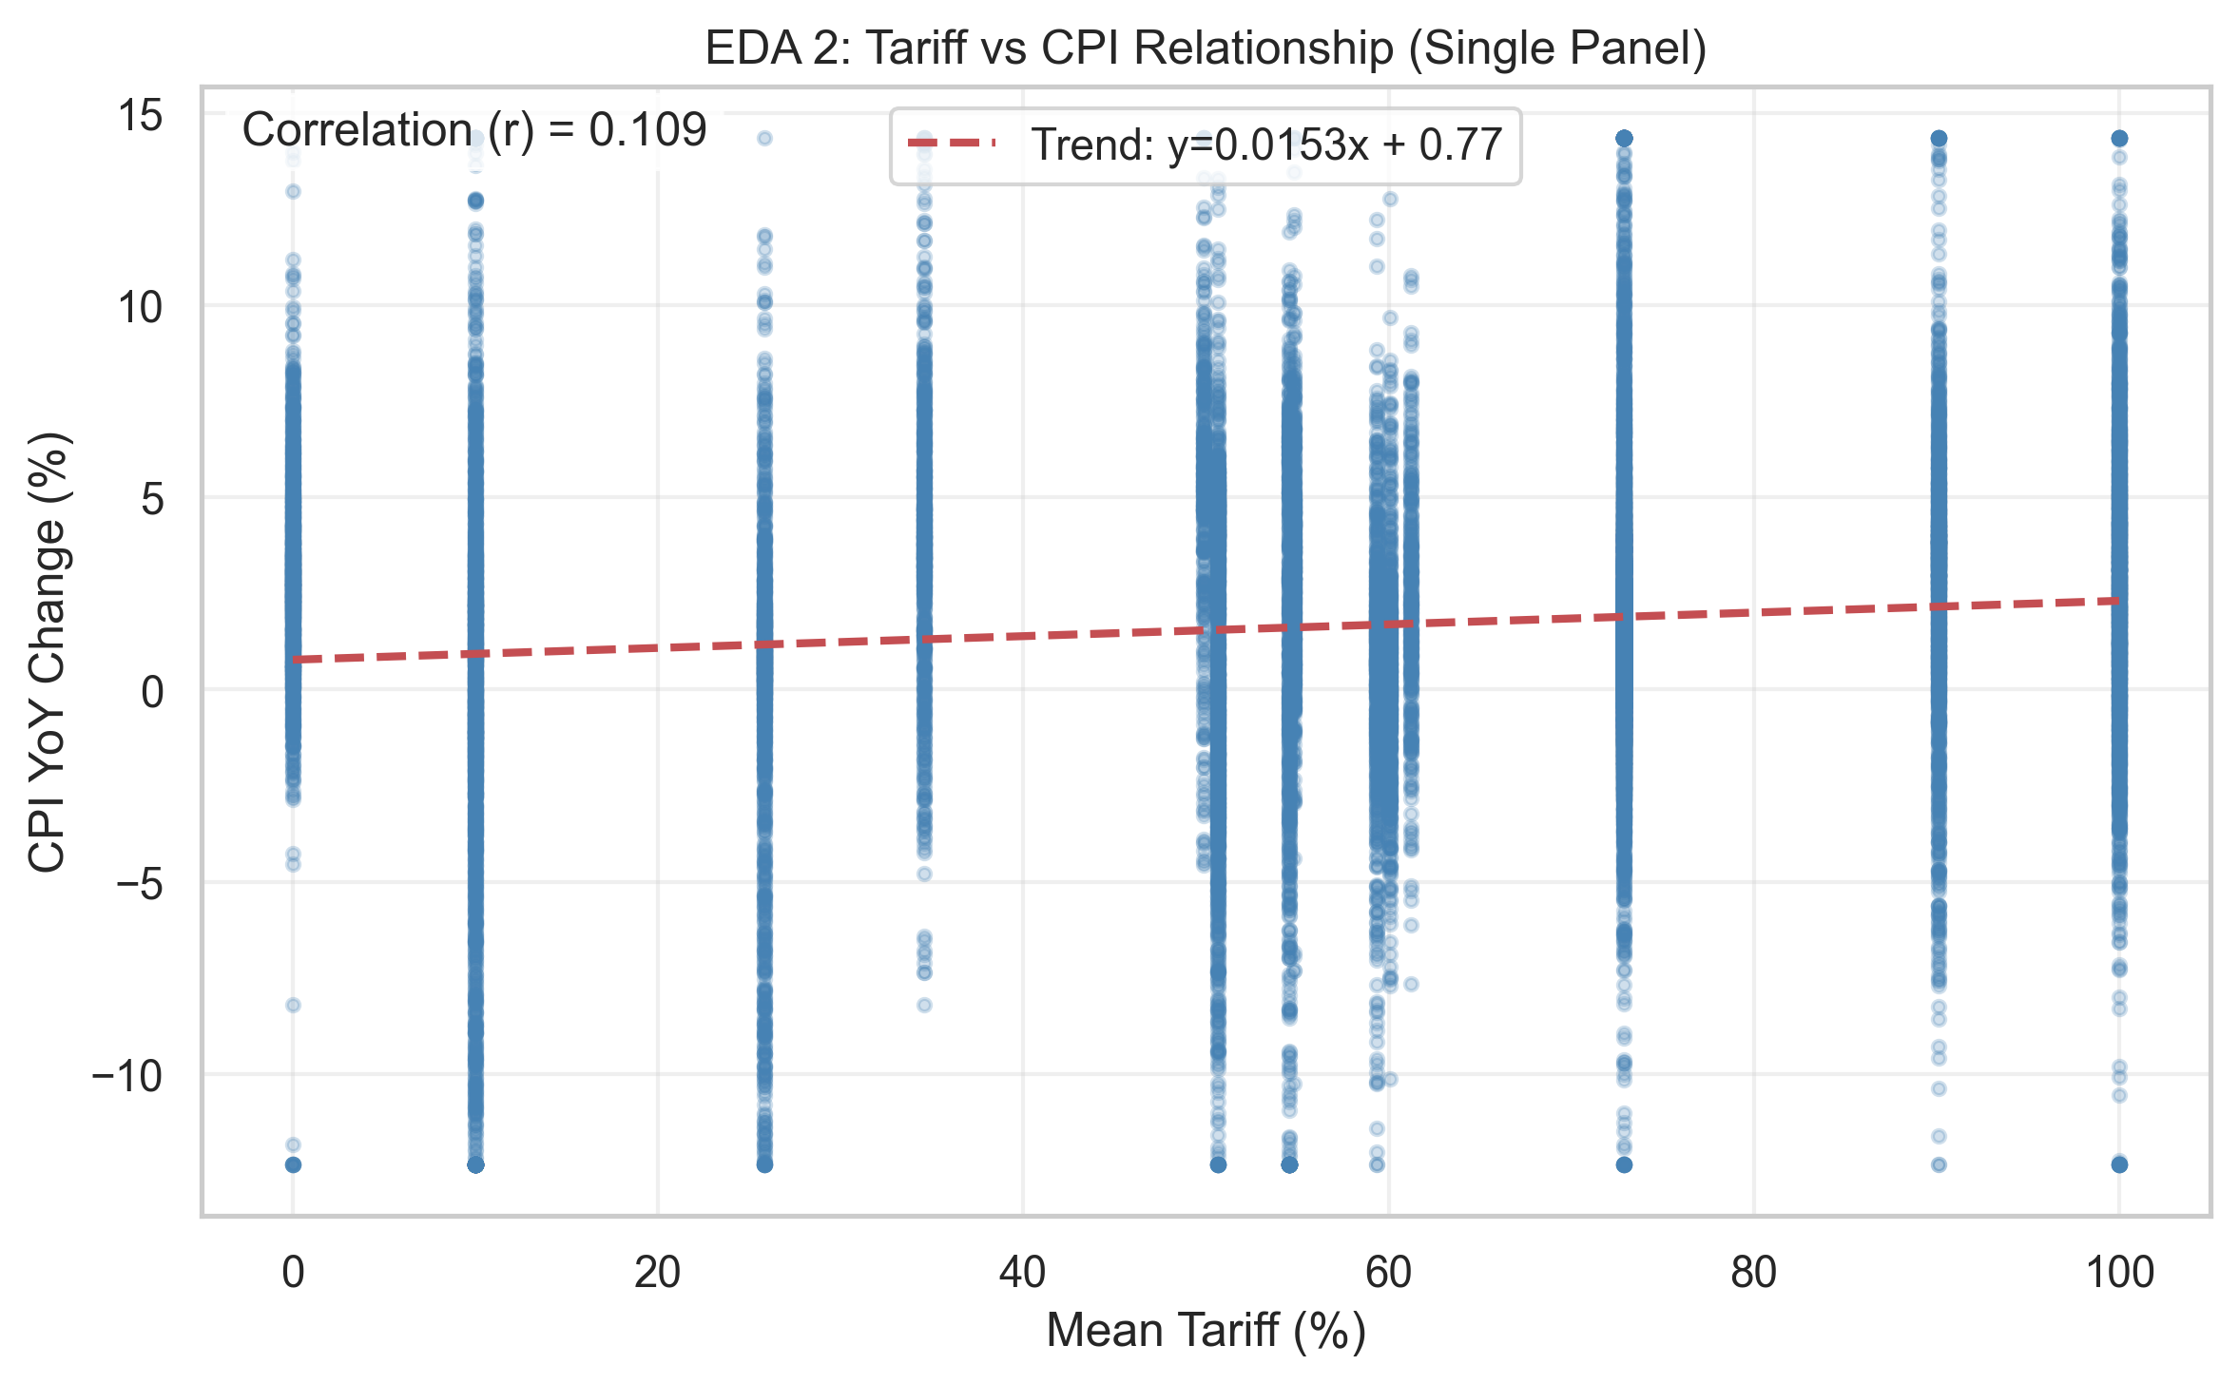
Tariff vs CPI Weak Relationship

Slide 7
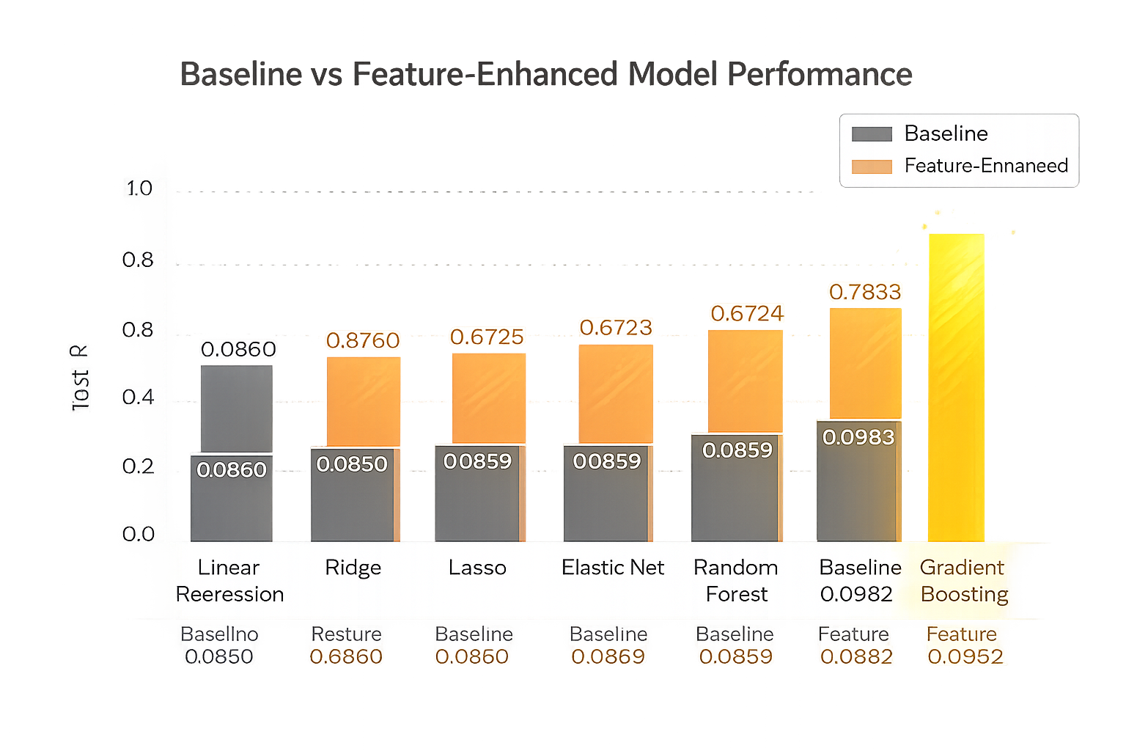
Model Comparison

Slide 8
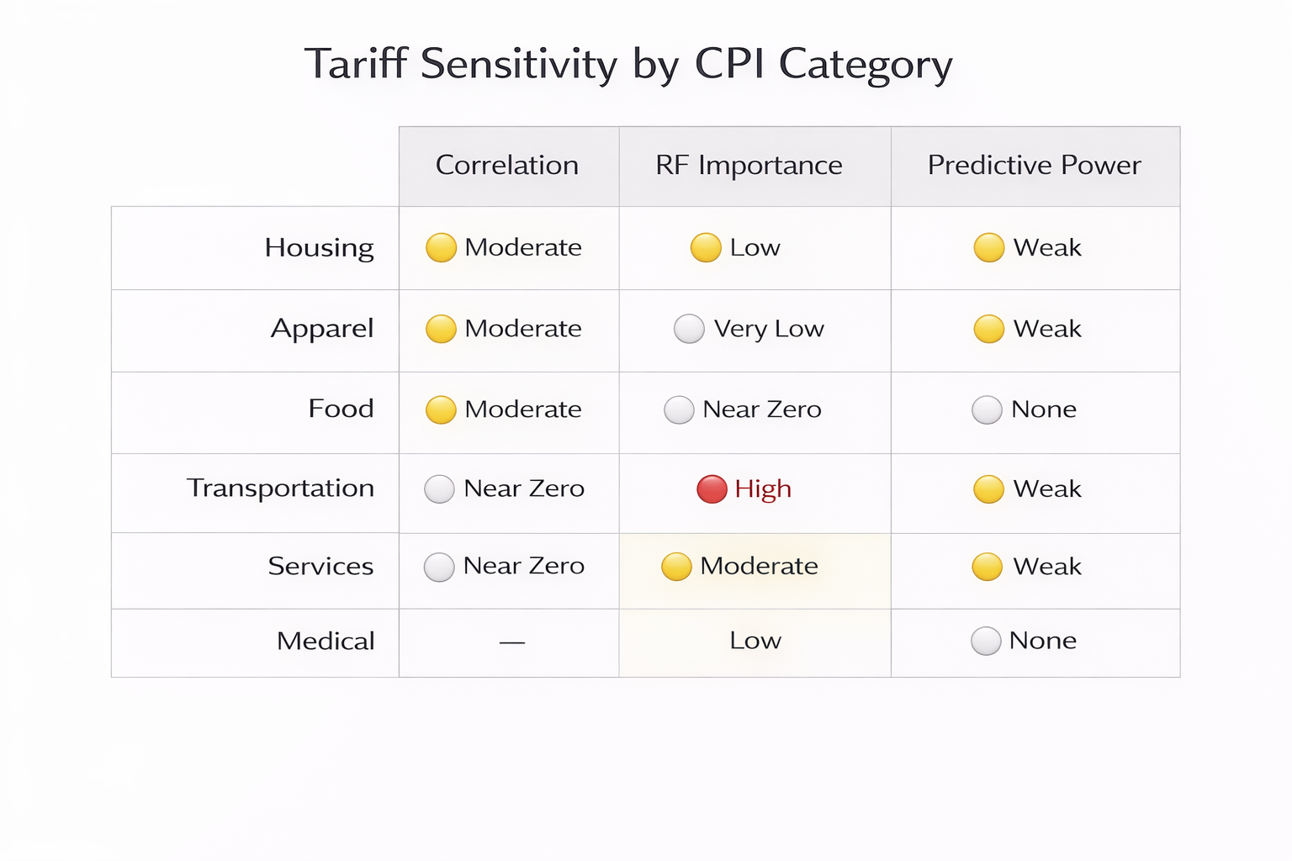

Slide 9
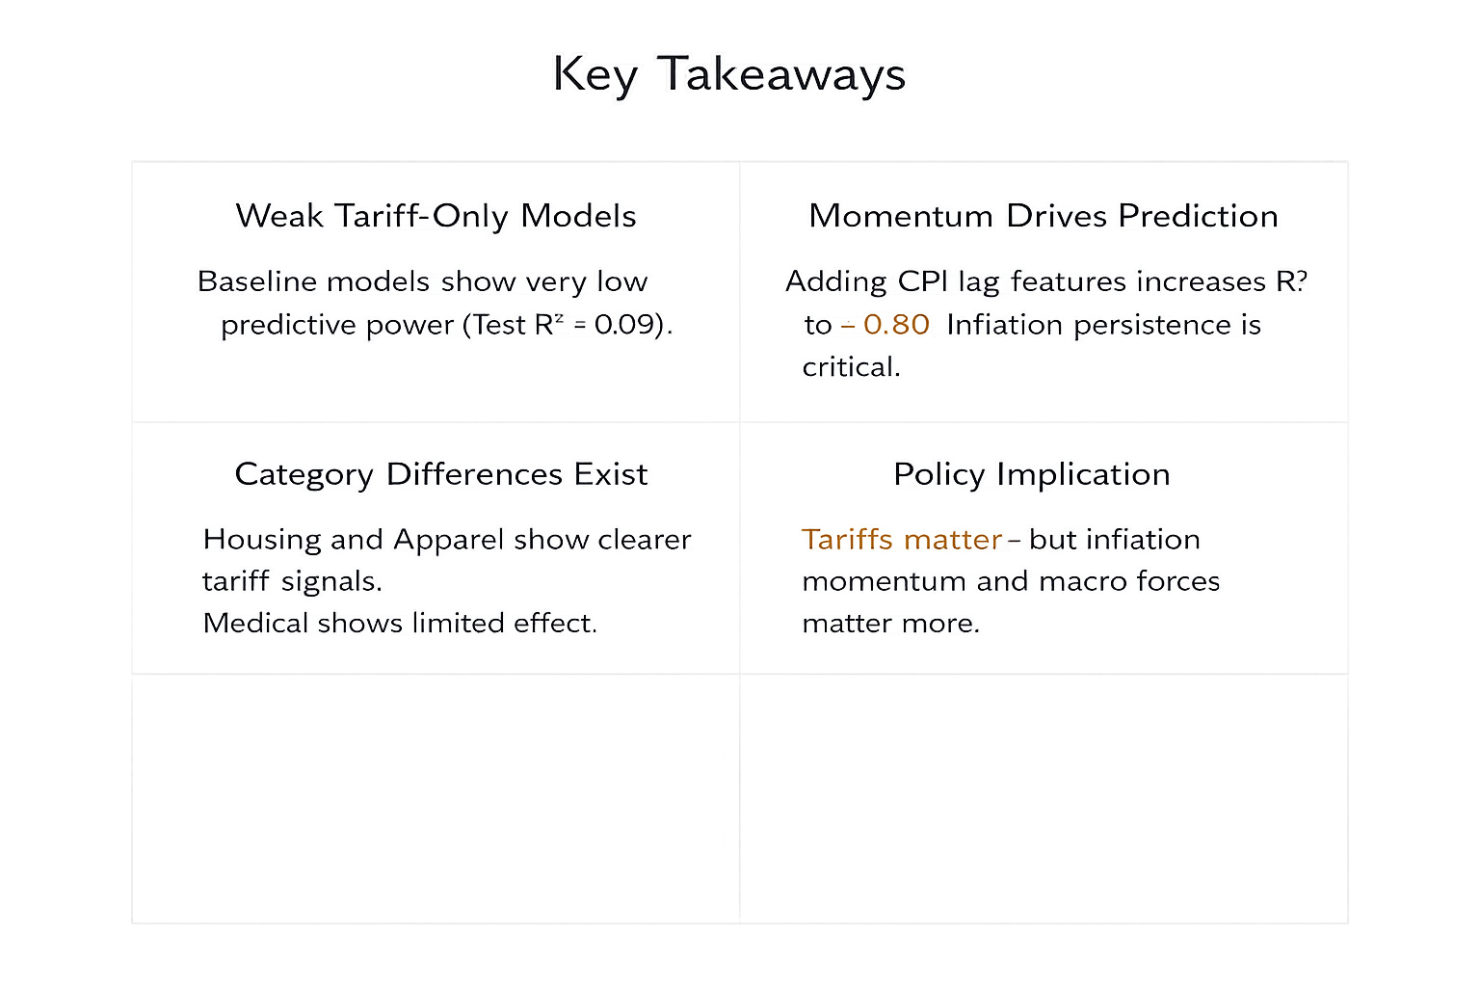

Slide 10
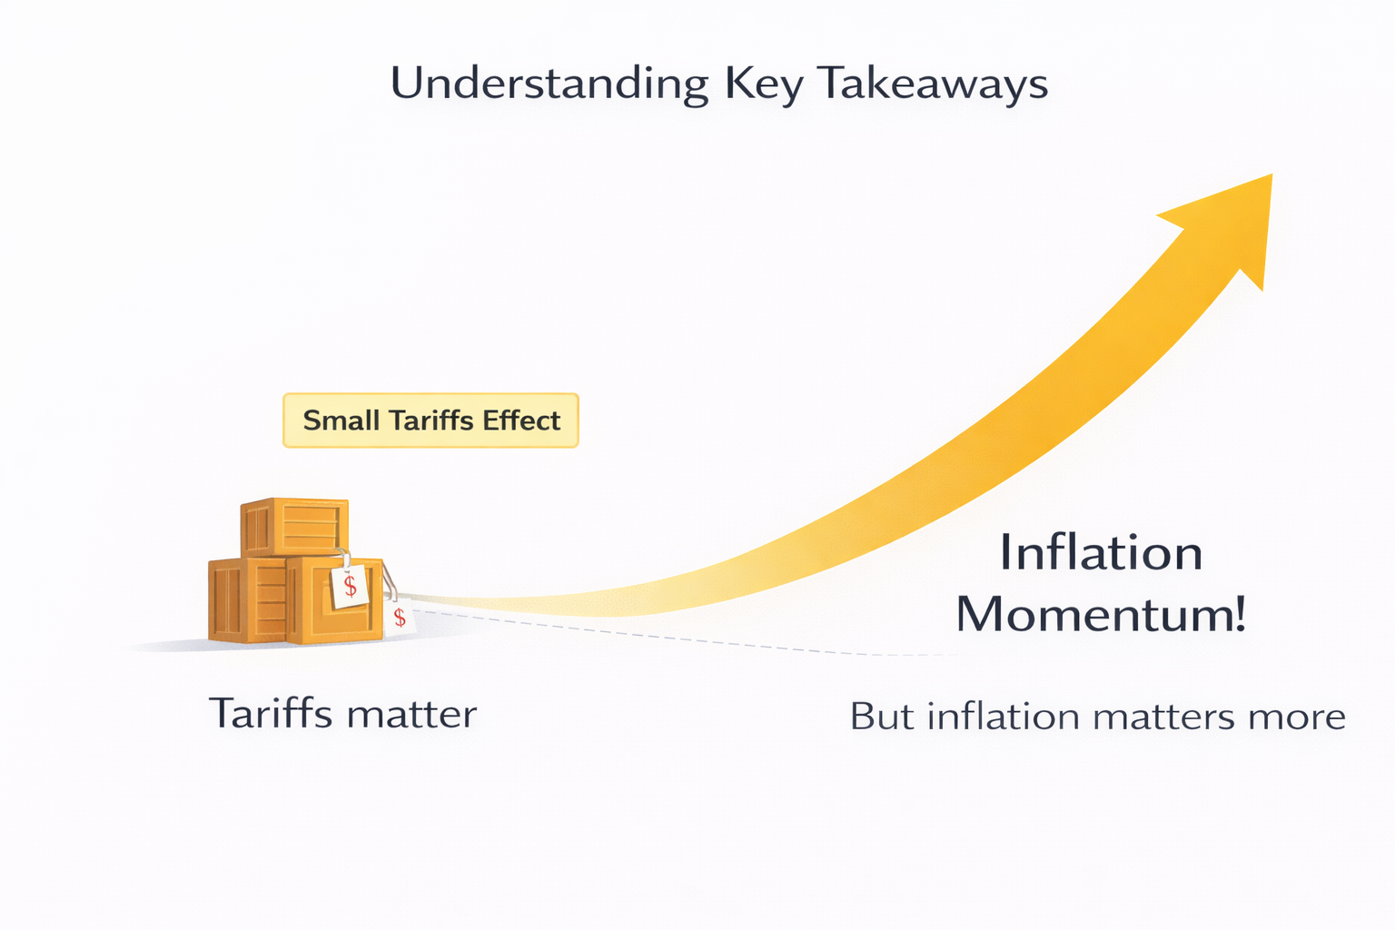

Slide 11
Thank you

